Slide 1

CHAPTER 1:
SCALE FROM ZERO TO MILLIONS OF USERS
System Design Interview: An Insider’s Guide
By Ali Khalaji

Slide 2
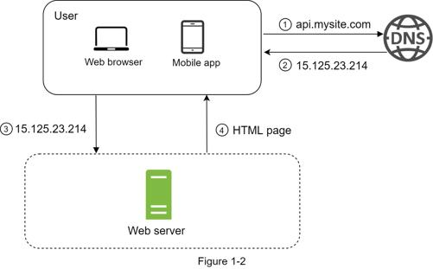
Single Server Setup
By Ali Khalaji
A journey of a thousand miles begins with a single step, and building a complex system is no different. To start with something simple, everything is running on a single server. Figure 1-1 shows the illustration of a single server setup where everything is running on one server: web app, database, cache, etc.
1. Users access websites through domain names, such as api.mysite.com. Usually, the Domain Name System (DNS) is a paid service provided by 3rd parties and not hosted by our servers.
2. Internet Protocol (IP) address is returned to the browser or mobile app. In the example, IP address 15.125.23.214 is returned.
3. Once the IP address is obtained, Hypertext Transfer Protocol (HTTP) [1] requests are sent directly to your web server.
4. The web server returns HTML pages or JSON response for rendering.

Slide 3
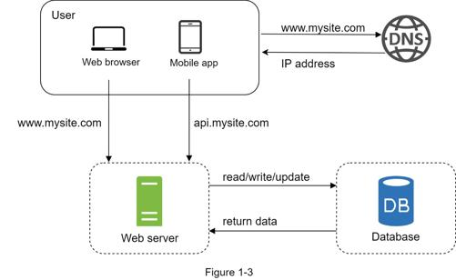
Data Base
By Ali Khalaji
With the growth of the user base, one server is not enough, and we need multiple servers: one for web/mobile traffic, the other for the database (Figure 1-3). Separating web/mobile traffic (web tier) and database (data tier) servers allows them to be scaled independently.
You can choose between a traditional relational database and a non-relational database. Let us examine their differences.
Relational databases are also called a relational database management system (RDBMS) or SQL database. The most popular ones are MySQL, Oracle database, PostgreSQL, etc. Relational databases represent and store data in tables and rows. You can perform join operations using SQL across different database tables.
Non-Relational databases are also called NoSQL databases. Popular ones are CouchDB, Neo4j, Cassandra, HBase, Amazon DynamoDB, etc. [2]. These databases are grouped into four categories: key-value stores, graph stores, column stores, and document stores. Join operations are generally not supported in non-relational databases.

Slide 4
Vertical VS Horizontal Scailing
Vertival (Scale Up)
Horizontal (Scale Out)
By Ali Khalaji
Add CPU cores, RAM and storage to one instance. Straightforward: no architectural redesign or distributed routing.
Vertical scaling has a hard limit. It is impossible to add unlimited CPU and memory to a single server.
Vertical scaling does not have failover and redundancy. If one server goes down, the website/app goes down with it completely.
Add servers to a pool to distribute capacity. Linear cost profile and practically limitless theoretical scale.
Horizontal scaling is more desirable for large scale applications due to the limitations of vertical scaling.
In the previous design, users are connected to the web server directly. Users will be unable to access the website if the web server is offline. In another scenario, if many users access the web server simultaneously and it reaches the web server’s load limit, users generally experience slower response or fail to connect to the server. A load balancer is the best technique to address these problems.

Slide 5
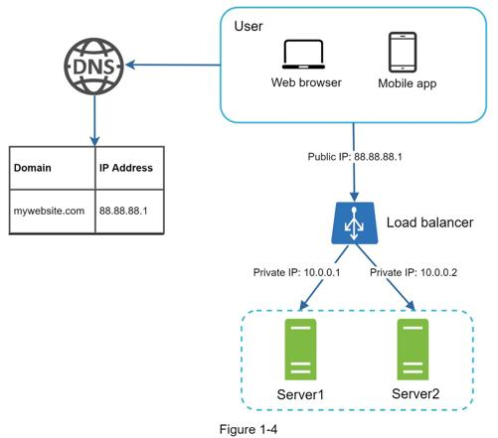
Load Balancer
By Ali Khalaji
A load balancer evenly distributes incoming traffic among web servers that are defined in a load-balanced set. Figure 1-4 shows how a load balancer works.
As shown in Figure 1-4, users connect to the public IP of the load balancer directly. With this setup, web servers are unreachable directly by clients anymore.
For better security, private IPs are used for communication between servers. A private IP is an IP address reachable only between servers in the same network; however, it is unreachable over the internet. The load balancer communicates with web servers through private IPs.
In Figure 1-4, after a load balancer and a second web server are added, we successfully solved no failover issue and improved the availability of the web tier. Details are explained below:
• If server 1 goes offline, all the traffic will be routed to server 2. This prevents the website from going offline. We will also add a new healthy web server to the server pool to balance the load.
• If the website traffic grows rapidly, and two servers are not enough to handle the traffic, the load balancer can handle this problem gracefully. You only need to add more servers to the web server pool, and the load balancer automatically starts to send requests to them.

Slide 6
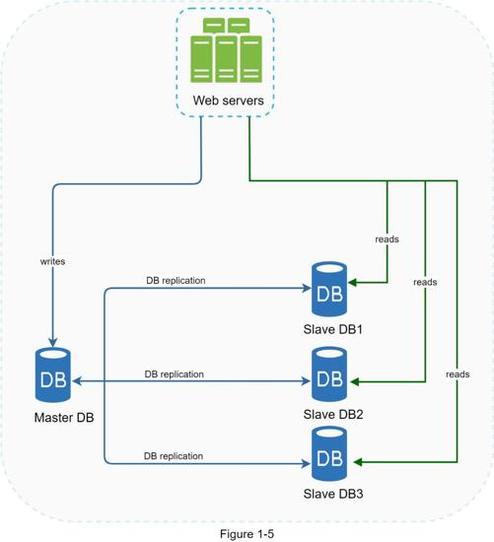
Database replication
By Ali Khalaji
Quoted from Wikipedia: “Database replication can be used in many database management systems, usually with a master/slave relationship between the original (master) and the copies (slaves)” [3].
A master database generally only supports write operations. A slave database gets copies of the data from the master database and only supports read operations.
All the data-modifying commands like insert, delete, or update must be sent to the master database.
Most applications require a much higher ratio of reads to writes; thus, the number of slave databases in a system is usually larger than the number of master databases.
Figure 1-5 shows a master database with multiple slave databases.

Slide 7
Advantages of database replication:
By Ali Khalaji
Better performance: In the master-slave model, all writes and updates happen in master nodes; whereas, read operations are distributed across slave nodes. This model improves performance because it allows more queries to be processed in parallel.
Reliability: If one of your database servers is destroyed by a natural disaster, such as a typhoon or an earthquake, data is still preserved. You do not need to worry about data loss because data is replicated across multiple locations.
High availability: By replicating data across different locations, your website remains in operation even if a database is offline as you can access data stored in another database server.
If only one slave database is available and it goes offline, read operations will be directed to the master database temporarily. As soon as the issue is found, a new slave database will replace the old one. In case multiple slave databases are available, read operations are redirected to other healthy slave databases. A new database server will replace the old one.

Slide 8
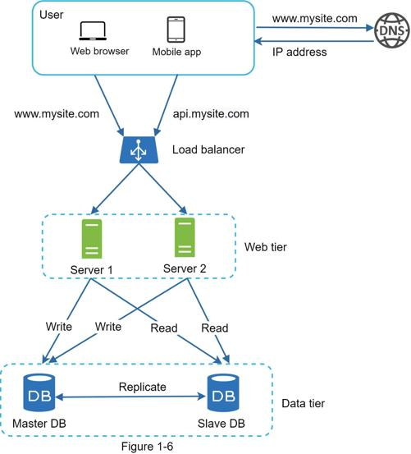
Figure 1-6 shows the system design after adding the load balancer and database replication.
By Ali Khalaji
Let us take a look at the design:
• A user gets the IP address of the load balancer from DNS.
• A user connects the load balancer with this IP address.
• The HTTP request is routed to either Server 1 or Server 2.
• A web server reads user data from a slave database.
• A web server routes any data-modifying operations to the master database. This includes write, update, and delete operations.
Now, you have a solid understanding of the web and data tiers, it is time to improve the load/response time. This can be done by adding a cache layer and shifting static content (JavaScript/CSS/image/video files) to the content delivery network (CDN).

Slide 9

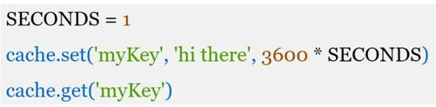
Cache
Cache tier
By Ali Khalaji
A cache is a temporary storage area that stores the result of expensive responses or frequently accessed data in memory so that subsequent requests are served more quickly. As illustrated in Figure 1-6, every time a new web page loads, one or more database calls are executed to fetch data. The application performance is greatly affected by calling the database repeatedly. The cache can mitigate this problem.
The cache tier is a temporary data store layer, much faster than the database. The benefits of having a separate cache tier include better system performance, ability to reduce database workloads, and the ability to scale the cache tier independently. Figure 1-7 shows a possible setup of a cache server:
After receiving a request, a web server first checks if the cache has the available response. If it has, it sends data back to the client. If not, it queries the database, stores the response in cache, and sends it back to the client. This caching strategy is called a read-through cache. Other caching strategies are available depending on the data type, size, and access patterns. A previous study explains how different caching strategies work [6].
Interacting with cache servers is simple because most cache servers provide APIs for common programming languages. The following code snippet shows typical Memcached APIs:

Slide 10
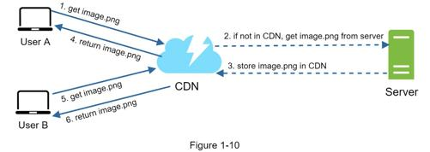
Content delivery network (CDN)
By Ali Khalaji
A CDN is a network of geographically dispersed servers used to deliver static content. CDN servers cache static content like images, videos, CSS, JavaScript files, etc.
Dynamic content caching is a relatively new concept and beyond the scope of this book. It enables the caching of HTML pages that are based on request path, query strings, cookies, and request headers. Refer to the article mentioned in reference material [9] for more about this. This book focuses on how to use CDN to cache static content.
Here is how CDN works at the high-level: when a user visits a website, a CDN server closest to the user will deliver static content. Intuitively, the further users are from CDN servers, the slower the website loads. For example, if CDN servers are in San Francisco, users in Los Angeles will get content faster than users in Europe.
1. User A tries to get image.png by using an image URL. The URL’s domain is provided by the CDN provider.
2. If the CDN server does not have image.png in the cache, the CDN server requests the file from the origin, which can be a web server or online storage like Amazon S3.
3. The origin returns image.png to the CDN server, which includes optional HTTP header Time-to-Live (TTL) which describes how long the image is cached.
4. The CDN caches the image and returns it to User A. The image remains cached in the CDN until the TTL expires.
5. User B sends a request to get the same image.
6. The image is returned from the cache as long as the TTL has not expired.

Slide 11
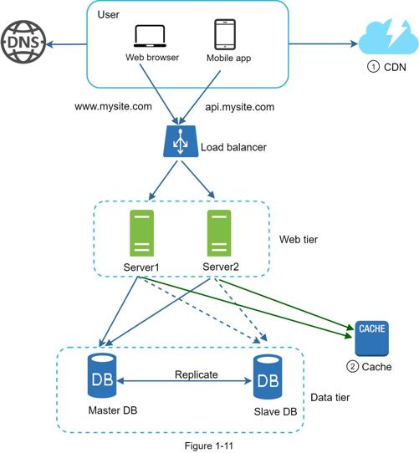
Figure 1-11 shows the design after the CDN and cache are added.
By Ali Khalaji
1. Static assets (JS, CSS, images, etc.,) are no longer served by web servers. They are fetched from the CDN for better performance.
2. The database load is lightened by caching data.

Slide 12
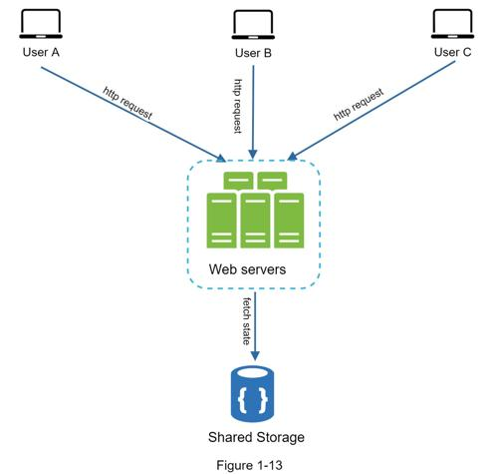
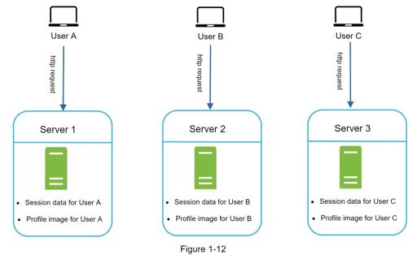
Stateless Vs Stateful architecture
Stateless architecture
Stateful architecture
Vertival (Scale Up)
By Ali Khalaji
Add CPU cores, RAM and storage to one instance. Straightforward: no architectural redesign or distributed routing.
Vertical scaling has a hard limit. It is impossible to add unlimited CPU and memory to a single server.
Vertical scaling does not have failover and redundancy. If one server goes down, the website/app goes down with it completely.
In Figure 1-12, user A’s session data and profile image are stored in Server 1. To authenticate User A, HTTP requests must be routed to Server 1. If a request is sent to other servers like Server 2, authentication would fail because Server 2 does not contain User A’s session data. Similarly, all HTTP requests from User B must be routed to Server 2; all requests from User C must be sent to Server 3.
In this stateless architecture, HTTP requests from users can be sent to any web servers, which fetch state data from a shared data store. State data is stored in a shared data store and kept out of web servers. A stateless system is simpler, more robust, and scalable.

Slide 13
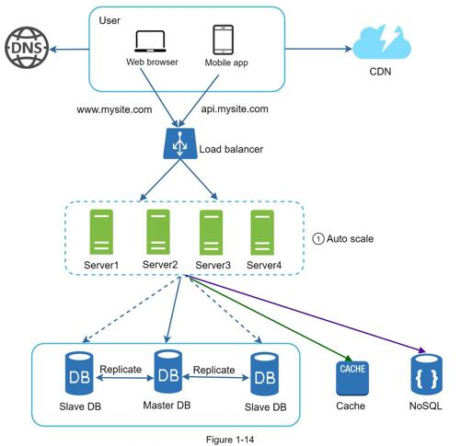
Figure 1-14 shows the updated design with a stateless web tier.
By Ali Khalaji
In Figure 1-14, we move the session data out of the web tier and store them in the persistent data store. The shared data store could be a relational database, Memcached/Redis, NoSQL, etc. The NoSQL data store is chosen as it is easy to scale. Autoscaling means adding or removing web servers automatically based on the traffic load. After the state data is removed out of web servers, auto-scaling of the web tier is easily achieved by adding or removing servers based on traffic load.
Your website grows rapidly and attracts a significant number of users internationally. To improve availability and provide a better user experience across wider geographical areas, supporting multiple data centers is crucial.

Slide 14
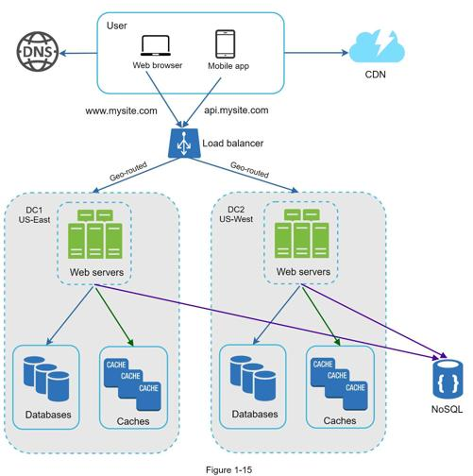
Data centers
By Ali Khalaji
Figure 1-15 shows an example setup with two data centers. In normal operation, users are geoDNS-routed, also known as geo-routed, to the closest data center, with a split traffic of x% in US-East and (100 – x)% in US-West. geoDNS is a DNS service that allows domain names to be resolved to IP addresses based on the location of a user.
Several technical challenges must be resolved to achieve multi-data center setup:
• Traffic redirection: Effective tools are needed to direct traffic to the correct data center. GeoDNS can be used to direct traffic to the nearest data center depending on where a user is located.
• Data synchronization: Users from different regions could use different local databases or caches. In failover cases, traffic might be routed to a data center where data is unavailable. A common strategy is to replicate data across multiple data centers. A previous study shows how Netflix implements asynchronous multi-data center replication [11].
• Test and deployment: With multi-data center setup, it is important to test your website/application at different locations. Automated deployment tools are vital to keep services consistent through all the data centers [11].
To further scale our system, we need to decouple different components of the system so they can be scaled independently. Messaging queue is a key strategy employed by many real-world distributed systems to solve this problem.

Slide 15
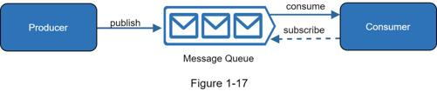
Message queue
By Ali Khalaji
A message queue is a durable component, stored in memory, that supports asynchronous communication. It serves as a buffer and distributes asynchronous requests. The basic architecture of a message queue is simple. Input services, called producers/publishers, create messages, and publish them to a message queue. Other services or servers, called consumers/subscribers, connect to the queue, and perform actions defined by the messages. The model is shown in Figure 1-17.
Decoupling makes the message queue a preferred architecture for building a scalable and reliable application. With the message queue, the producer can post a message to the queue when the consumer is unavailable to process it. The consumer can read messages from the queue even when the producer is unavailable.

Slide 16
Logging, metrics, automation
By Ali Khalaji
When working with a small website that runs on a few servers, logging, metrics, and automation support are good practices but not a necessity. However, now that your site has grown to serve a large business, investing in those tools is essential.
Logging: Monitoring error logs is important because it helps to identify errors and problems in the system. You can monitor error logs at per server level or use tools to aggregate them to a centralized service for easy search and viewing.
Metrics: Collecting different types of metrics help us to gain business insights and understand the health status of the system. Some of the following metrics are useful:
•Host level metrics: CPU, Memory, disk I/O, etc.
•Aggregated level metrics: for example, the performance of the entire database tier, cache tier, etc.
•Key business metrics: daily active users, retention, revenue, etc.
Automation: When a system gets big and complex, we need to build or leverage automation tools to improve productivity. Continuous integration is a good practice, in which each code check-in is verified through automation, allowing teams to detect problems early. Besides, automating your build, test, deploy process, etc. could improve developer productivity significantly.

Slide 17
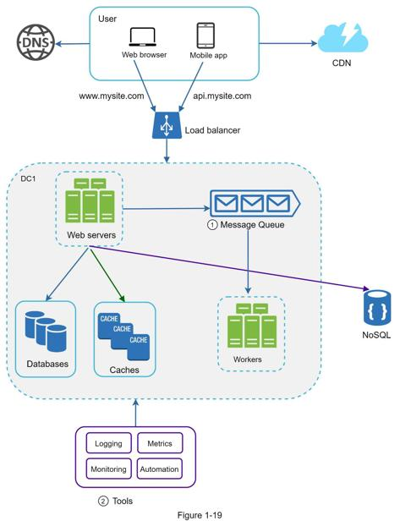
By Ali Khalaji
Figure 1-19 shows the updated design. Due to the space constraint, only one data center is shown in the figure.
1. The design includes a message queue, which helps to make the system more loosely coupled and failure resilient.
2. Logging, monitoring, metrics, and automation tools are included.

Slide 18
Millions of users and beyond
Scaling a system is an iterative process. Iterating on what we have learned in this chapter could get us far. More fine-tuning and new strategies are needed to scale beyond millions of users. For example, you might need to optimize your system and decouple the system to even smaller services. All the techniques learned in this chapter should provide a good foundation to tackle new challenges. To conclude this chapter, we provide a summary of how we scale our system to support millions of users:
•Keep web tier stateless
•Build redundancy at every tier
•Cache data as much as you can
•Support multiple data centers
•Host static assets in CDN
•Scale your data tier by sharding
•Split tiers into individual services
•Monitor your system and use automation tools
Congratulations on getting this far! Now give yourself a pat on the back. Good job!

Slide 19
Thank
you
By Ali Khalaji
https://github.com/A-Khalaji

